Slide 1
9.2. Content-Based Recommendations
Vo Ngoc Huy Thong

Slide 2
Outline
1
Introduction
2
Item Profiles
3
Discovering Features of Documents
4
5
6
7
Obtaining Features From Tags
Representing Item Profiles
User Profiles
Recommending Items
8
Classification Algorithms

Slide 3
1. Introduction
Two Architectures:
Content-Based Systems:
Focus on item properties.
Measure item similarity based on features.
Collaborative Filtering:
Focus on user-item relationships.
Measure similarity based on user behavior.
Focus of this Section: Content-Based Recommendations.

Slide 4
2. Item Profiles
Definition: An item profile is a collection of features representing an item’s important characteristics. These profiles help systems determine item similarity based on their content.
Features: Different types of items have specific features.
Examples:
Books:
Features like author, publication year, and genre.
Music:
Features like artist, composer, and genre.
Products:
Physical attributes such as screen size or color (e.g., for TVs).

Slide 5
2. Item Profiles
Movies:
Actors: Users may prefer movies with favorite actors.
Director: A user may like films by specific directors.
Year of Production: Preferences for old classics or modern movies.
Genre: Comedies, dramas, or specific categories like sci-fi or romance.
Key Insights:
Most features are easily extractable from metadata (e.g., descriptions, reviews).
Genre, while important, can be vague and may require classification techniques.

Slide 6
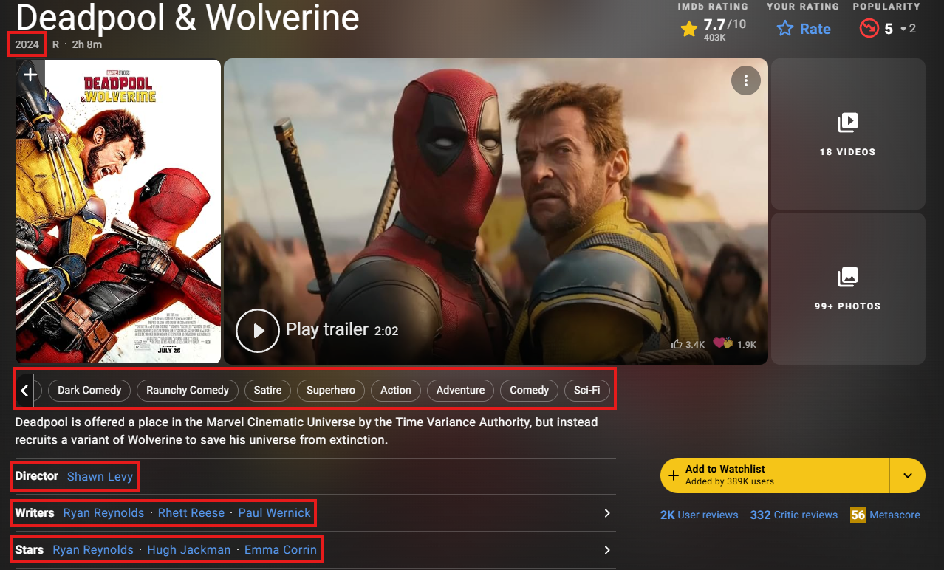
2. Item Profiles
Real-World Application: Internet Movie Database (IMDB) assigns genres to movies, helping with profile creation.

Slide 7
3. Discovering Features of Documents
Problem: For items like documents, webpages, or blogs, metadata may not exist, making it harder to define features.
Solution:
Extract features directly from content using the following steps:
Remove Stop Words: Common words like "the" and "and" are ignored as they add little value.
TF-IDF (Term Frequency-Inverse Document Frequency):
Identifies words that are important to the document.
High TF-IDF scores indicate distinguishing words.
Examples: In a news article, names (e.g., “Biden”) or event-specific terms (e.g., “summit”) often have high scores.
Represent Documents as Word Sets or Vectors:
Select top n words based on TF-IDF scores.
Represent these words as features.

Slide 8
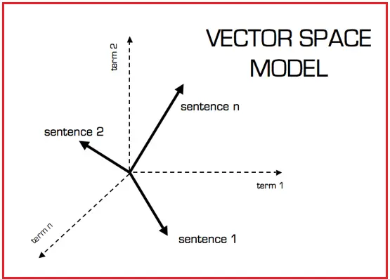
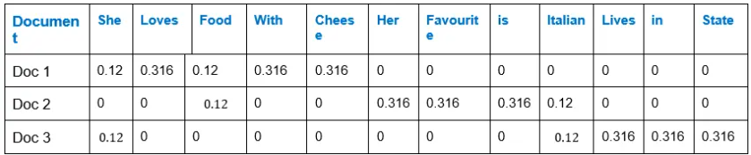
3. Discovering Features of Documents
Similarity Measures:
Jaccard Distance: Measures overlap between word sets.
Cosine Distance: Considers vectors' angle, emphasizing the similarity of important words.
Applications:
News article recommendations based on keywords.
Blog or webpage recommendations based on content similarity.

Slide 9

4. Obtaining Item Features From Tags
Problem: Some items, like images, lack intrinsic, meaningful features (e.g., pixel data tells little about content).
Solution:
Leverage user-supplied tags to describe items.
Tags capture semantic information.
Use Case: Early tagging platforms like del.icio.us allowed users to tag webpages, creating searchable metadata.
Challenges:
Tags depend on user participation.
Erroneous or biased tags can affect recommendation accuracy.

Slide 10
5. Representing Item Profiles
Methodology: Item profiles are represented as vectors. Features in the vector can be:
Boolean: Indicates presence (1) or absence (0) of a feature (e.g., an actor or a director or a genre in a movie).
Numerical: Represents measurable attributes (e.g., a movie’s average rating, a PC’s screen size or disk capacity).
Feature Combination:
Profiles can combine Boolean and numerical features.
Proper scaling ensures numerical features don’t dominate or underweight cosine similarity calculations.

Slide 11


5. Representing Item Profiles
Example:
Two movies have five actors each, with two overlapping actors.
Their average ratings are 3 and 4, respectively.
Cosine similarity is calculated by scaling ratings and counting shared features.
Cosine Similarity =
α = 1/2 → Cosine Similarity = 0.619
α = 1 → Cosine Similarity = 0.816
α = 2 → Cosine Similarity = 0.940

Slide 12
6. User Profiles
Definition: A user profile aggregates the features of items a user has interacted with.
Methodology: Use the utility matrix to identify user-item interactions. Construct profiles based on:
Boolean Utility Matrix:
Example: If 20% of a user’s liked movies feature Julia Roberts, their profile assigns 0.2 to Julia Roberts’ component.
Numerical Utility Matrix:
Normalize ratings by subtracting the user’s average score.
Positive and negative weights represent preference intensity.
Example: A user who rates Julia Roberts’ movies highly will have a higher weight for her in their profile.

Slide 13
7. Recommending Items to Users Based on Content
Methodology:
Compare user profiles with item profiles using cosine similarity.
Items with higher similarity are recommended.
Optimization:
Use Locality-Sensitive Hashing (LSH) to group similar items for efficient recommendation.
Examples:
Movies with many actors from the user’s liked movies will have higher similarity scores.
Movies featuring disliked actors will have lower similarity scores.

Slide 14
8. Classification Algorithms
Alternative Approach: Treat recommendation as a classification problem.
Methodology:
Use machine learning (e.g., decision trees) to classify items as "like" or "dislike.“
Train classifiers using user-item interaction data (utility matrix).
Challenges:
Building one classifier per user is computationally expensive.
Requires evaluating multiple predicates and combinations of features.

Slide 15
Thank you for your listening!

